Slide 1
Edge Security Bootcamp
OAuth - Authorization Code

Slide 2
OAuth grants
An OAuth Grant is a credential representing the resource owner’s authorization. More often than not, we tend to think of grants in terms of the process used to obtain an access token.
Grant Type | Typical Use Case | Complex?
No specific resource owner is involved
Client Credentials | Business system interactions, where resources being operated on are owned by the partner, not a particular user | No
A specific resource owner is involved
Resource Owner Password Credentials | Resources are owned by a particular user and the requesting application is trusted | A bit
Authorization Code | Resources are owned by a particular user and the requesting application is untrusted | Very
Implicit | Resources are owned by a particular user, and the requesting application is an untrusted browser-based app written in a scripting language such as JavaScript | Very, and potentially insecure as well

Slide 3
Authorization code grant type
Resources participating in authorization code grant type
End user
Client application
User agent
Edge - generating and validating token
Authentication server - to validate the credentials
Backend API resource
Resource owner is involved, typically owned by user and requesting application is untrusted
Very complex to implement compared to client credentials or password grant type
More secure than password grant type
Refresh token generated along with bearer token

Slide 4
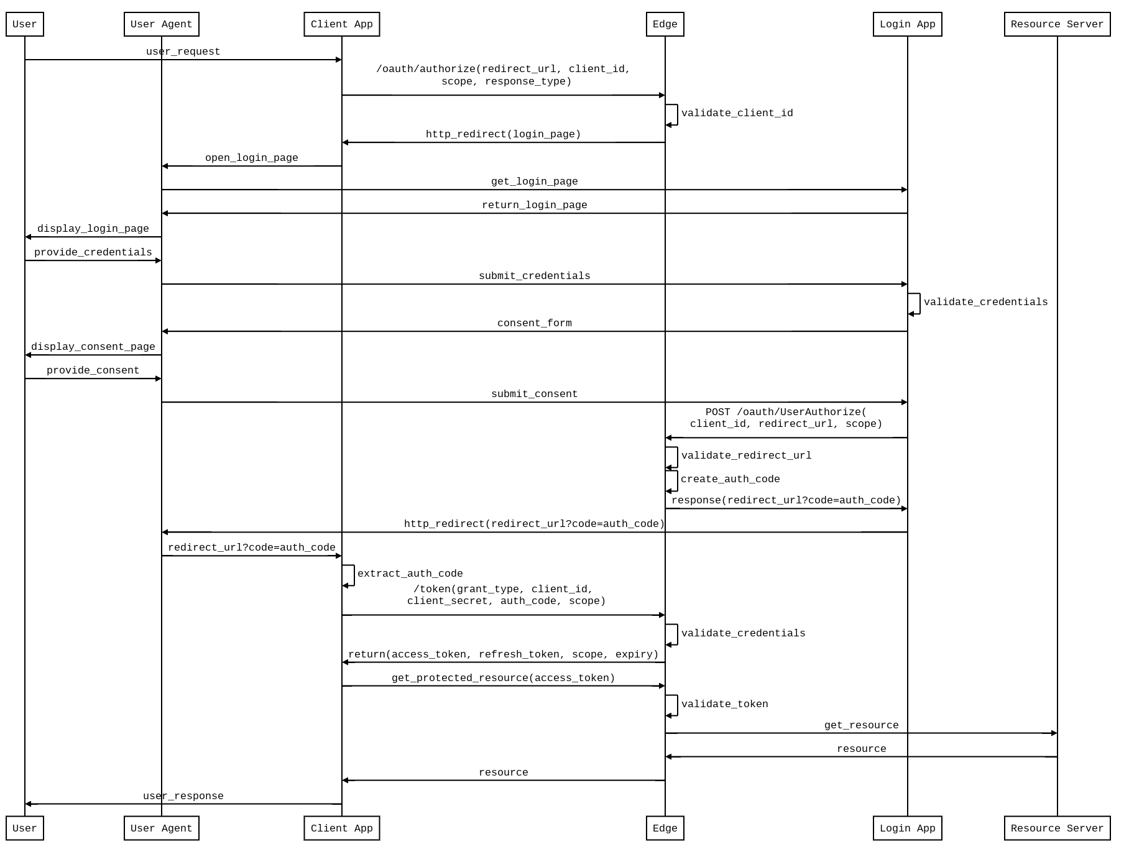
Authorization code - Sequence diagram

Slide 5
Generate authorization code
<OAuthV2 async="false" continueOnError="false" enabled="true" name="GetAuthCode">
<DisplayName>GetAuthCode</DisplayName>
<Operation>GenerateAuthorizationCode</Operation>
<ExpiresIn>600000</ExpiresIn>
<GenerateResponse/>
</OAuthV2>

Slide 6
Exchange authorization code for access token
<OAuthV2 name="GetAccessToken">
<Operation>GenerateAccessToken</Operation>
<ExpiresIn>360000000</ExpiresIn>
<SupportedGrantTypes>
<GrantType>authorization_code</GrantType>
</SupportedGrantTypes>
<GrantType>request.queryparam.grant_type</GrantType>
<GenerateResponse/>
</OAuthV2>

Slide 7
Verify OAuth token policy
The OAuthV2 policy’s VerifyAccessToken operation will validate the access token for subsequent requests for all grant types.
Set the access token as the bearer token in the authorization header of the http request.
<?xml version="1.0" encoding="UTF-8" standalone="yes"?>
<OAuthV2 async="false" continueOnError="false" enabled="true" name="VerifyOAuthToken">
<DisplayName>OAuth Verify Token</DisplayName>
<Operation>VerifyAccessToken</Operation>
</OAuthV2>
curl -H "Authorization: Bearer {access_token}" http://myorg-test.apigee.net/v1/cc/oauth_cc_weather/forecastrss?w=12797282

Slide 8
THANK YOU

